Slide 1

INNOVATION AND Self DRIVING CARS

Slide 2


Slide 3

Light Bulb

Slide 4
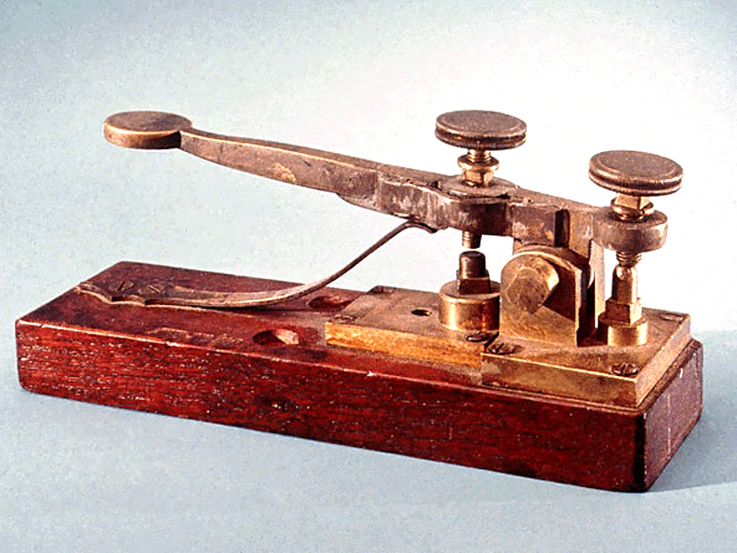
TELEGRAPH

Slide 5

COMPUTER

Slide 6
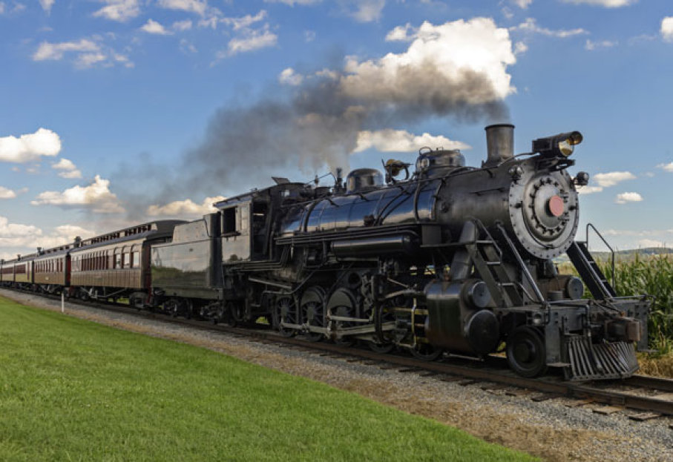
STEAM ENGINE

Slide 7
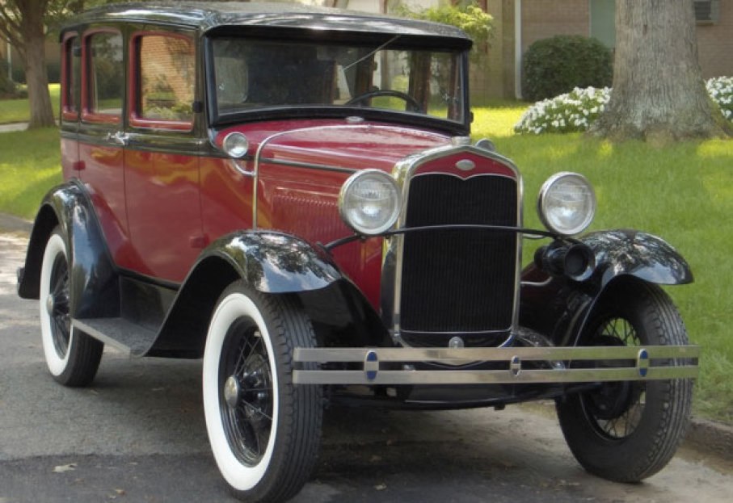
AUTOMOBILE

Slide 8
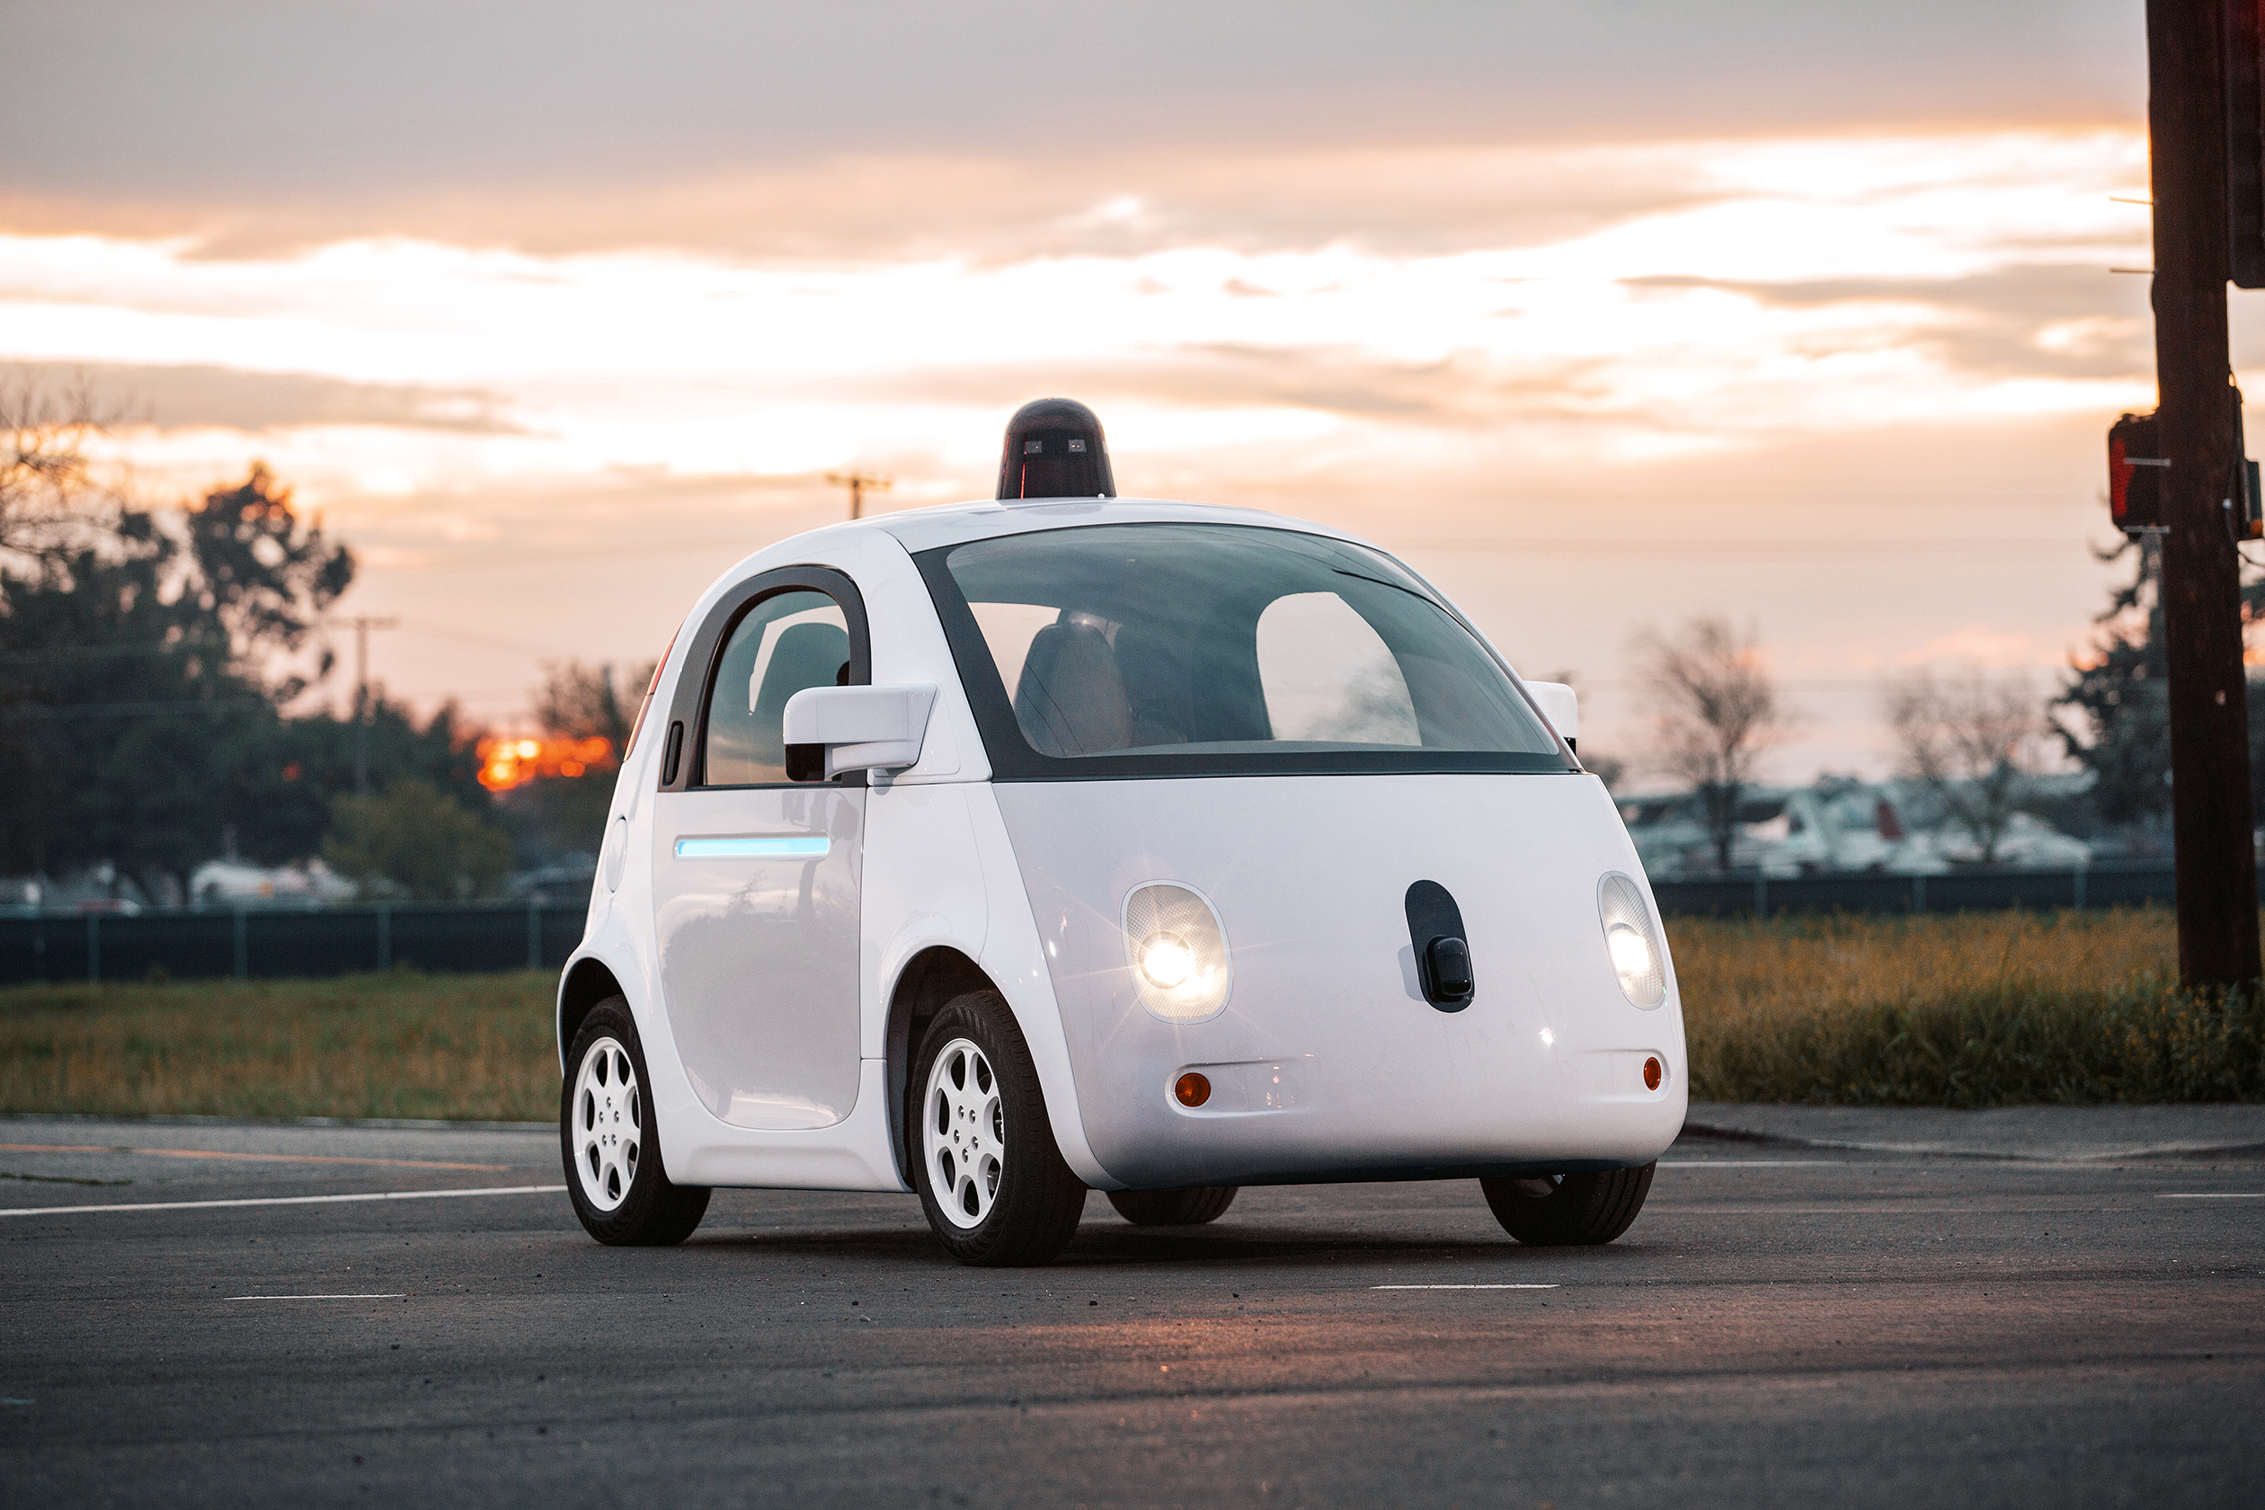
SELF DRIVING CAR

Slide 9


Slide 10

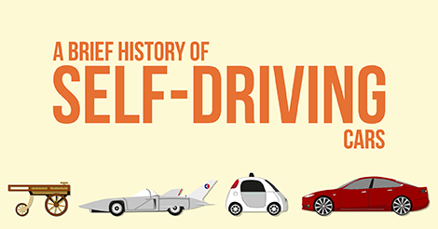

Slide 11
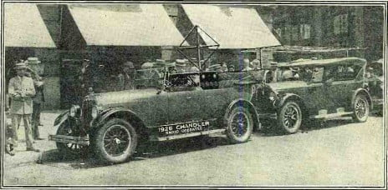
THE DRIVERLESS DREAM BEGINS

Slide 12

JOHN MCCARTHY’S ROBO-CHAUFFEUR

Slide 13
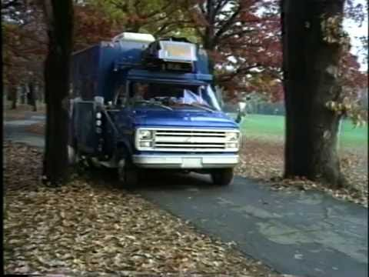
NO HANDS ACROSS AMERICA

Slide 14
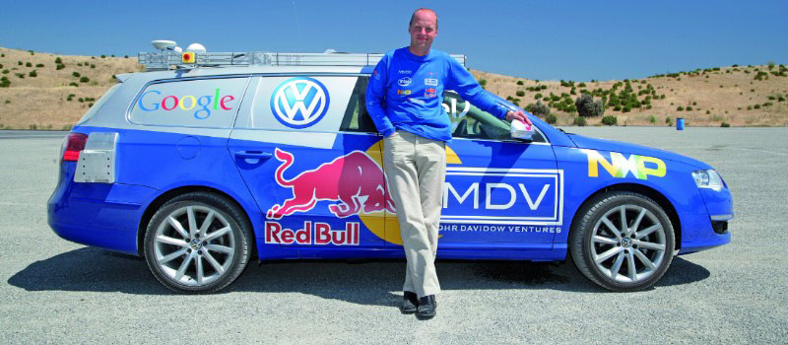
THE GRAND CHALLENGE IS TOO CHALLENGING

Slide 15
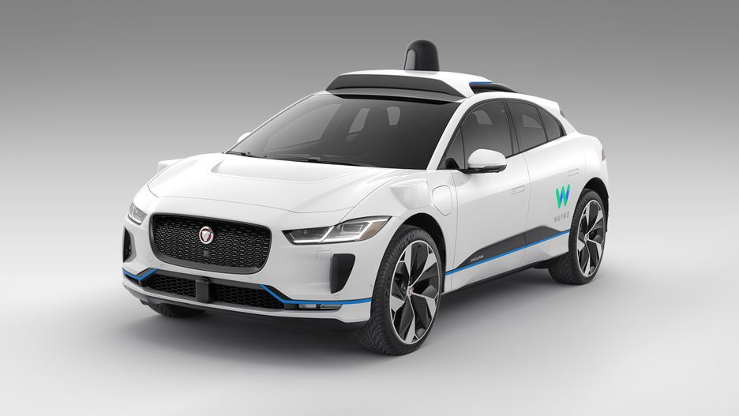
GOOGLE SEARCHES FOR AN ANSWER

Slide 16
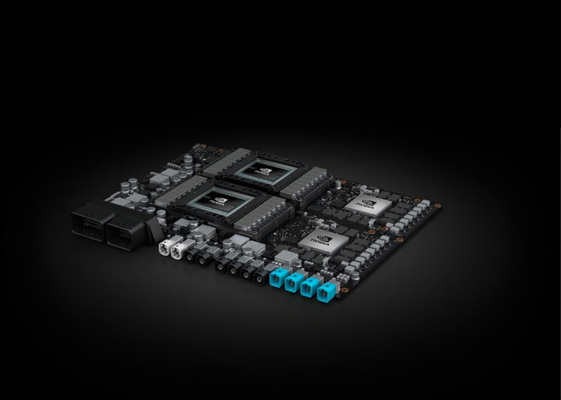
AI COMES TO SELF-DRIVING CARS

Slide 17
Autonomy LEVELS
Level 0
Level 1
Level 2
Level 3
Level 4
Level 5
No automation
Limited driver assistance
Driver-assist systems
Autonomous mode in certain situations
autonomous mode most of the times
Fully autonomous

Slide 18

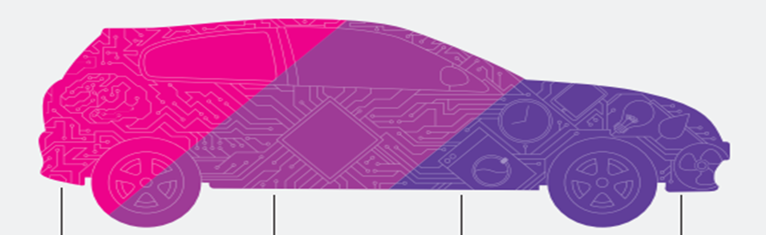
WHAT MAKES DRIVERLESS CARS POSSIBLE ?
Sensors
Processors
Artificial Intelligence
Control

Slide 19
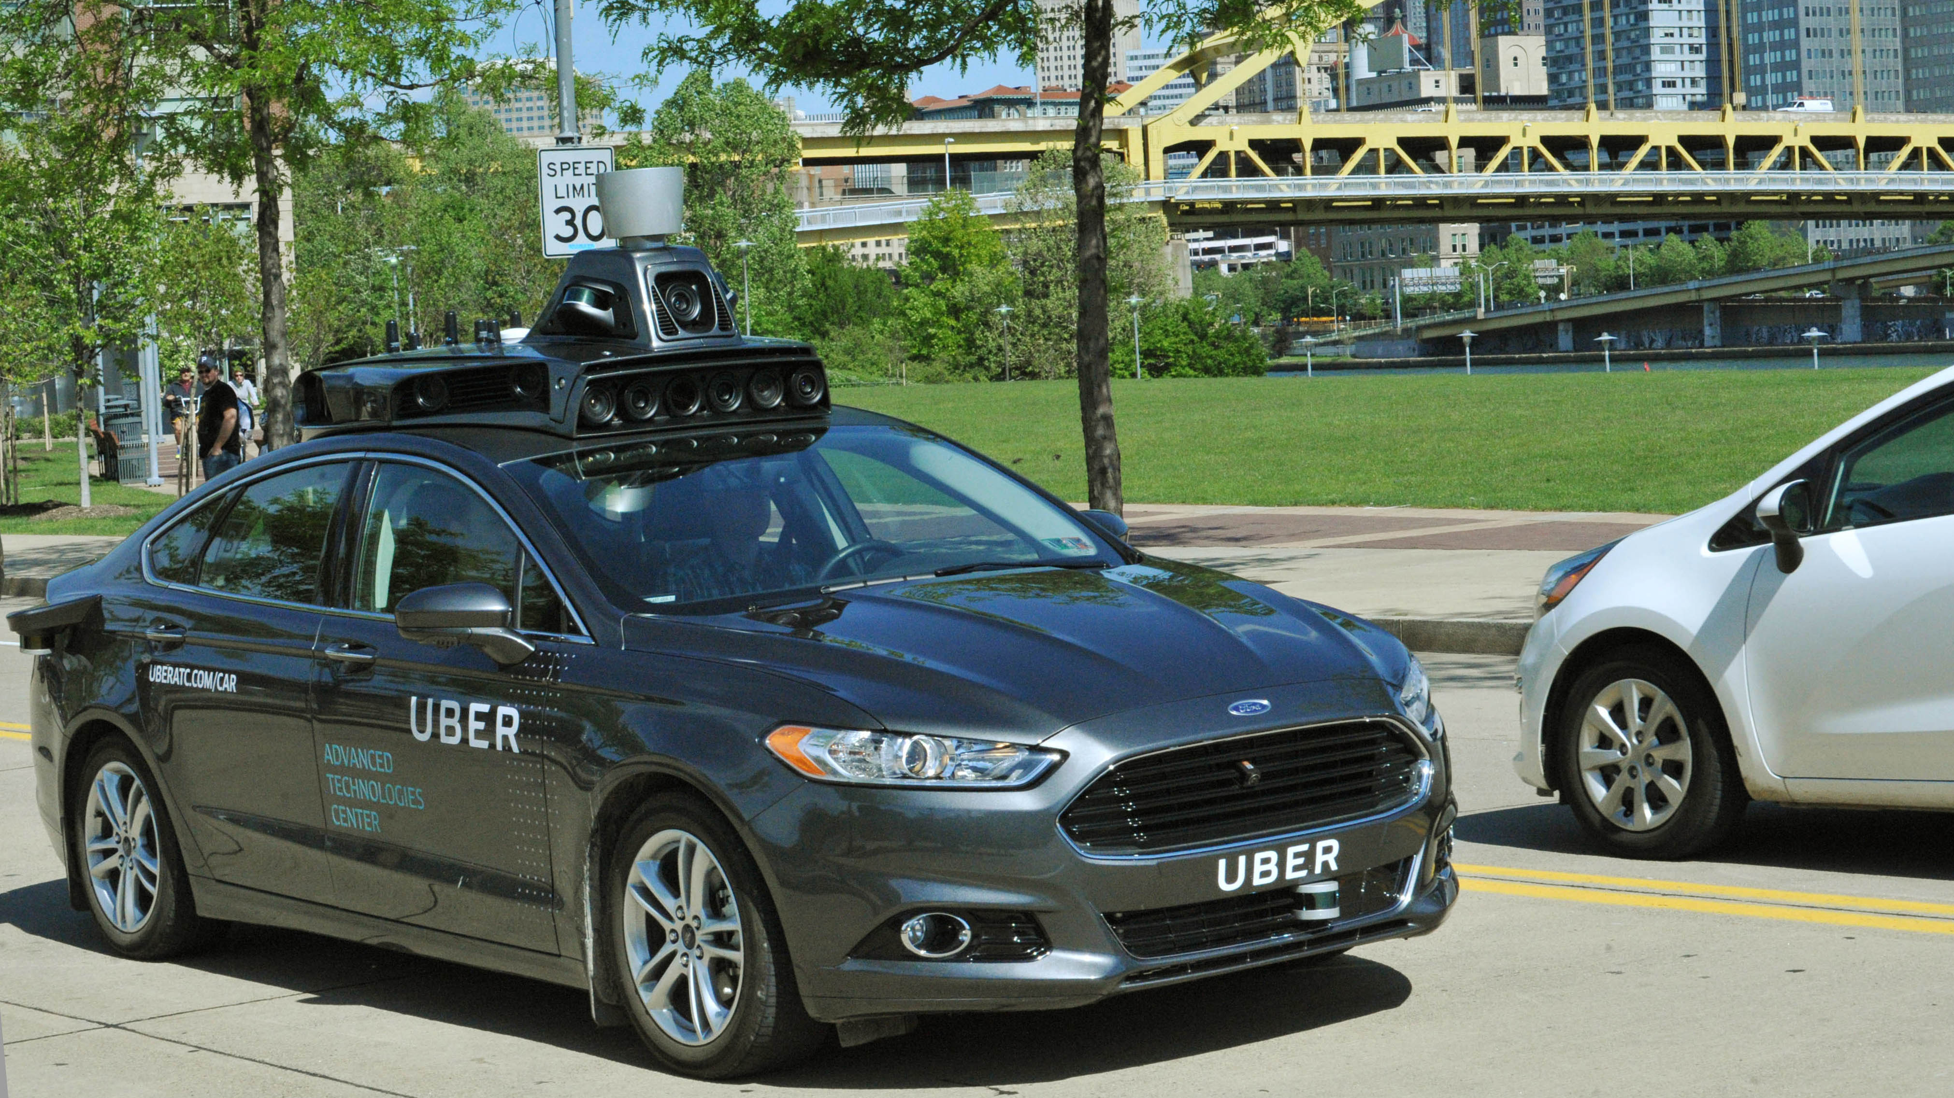
How a car drives itself

Slide 20
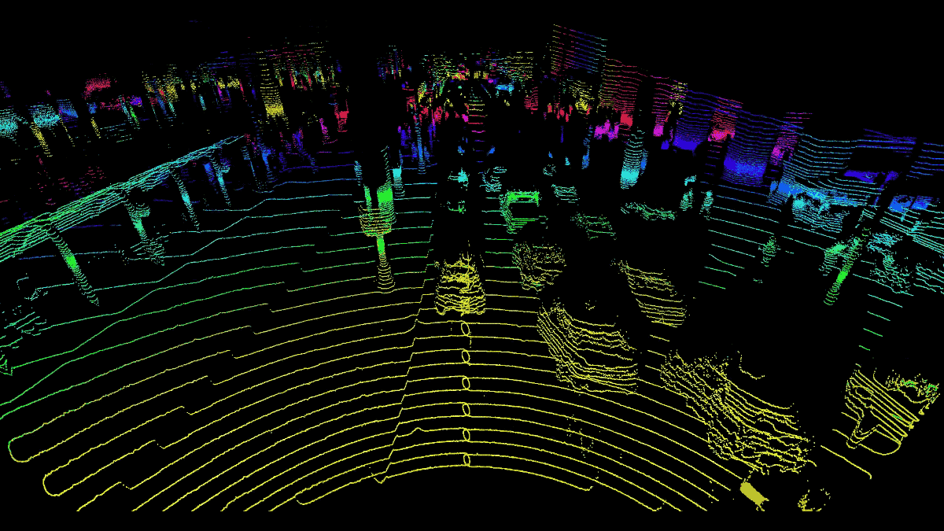

Lidar

Slide 21
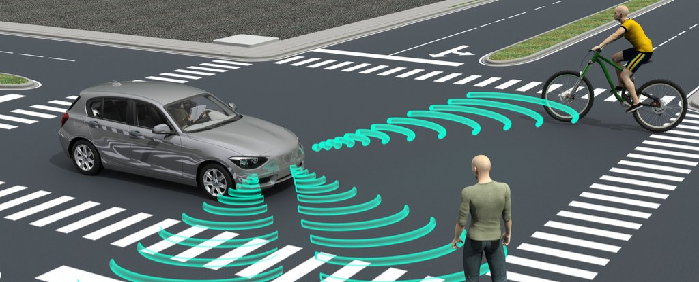

radar

Slide 22
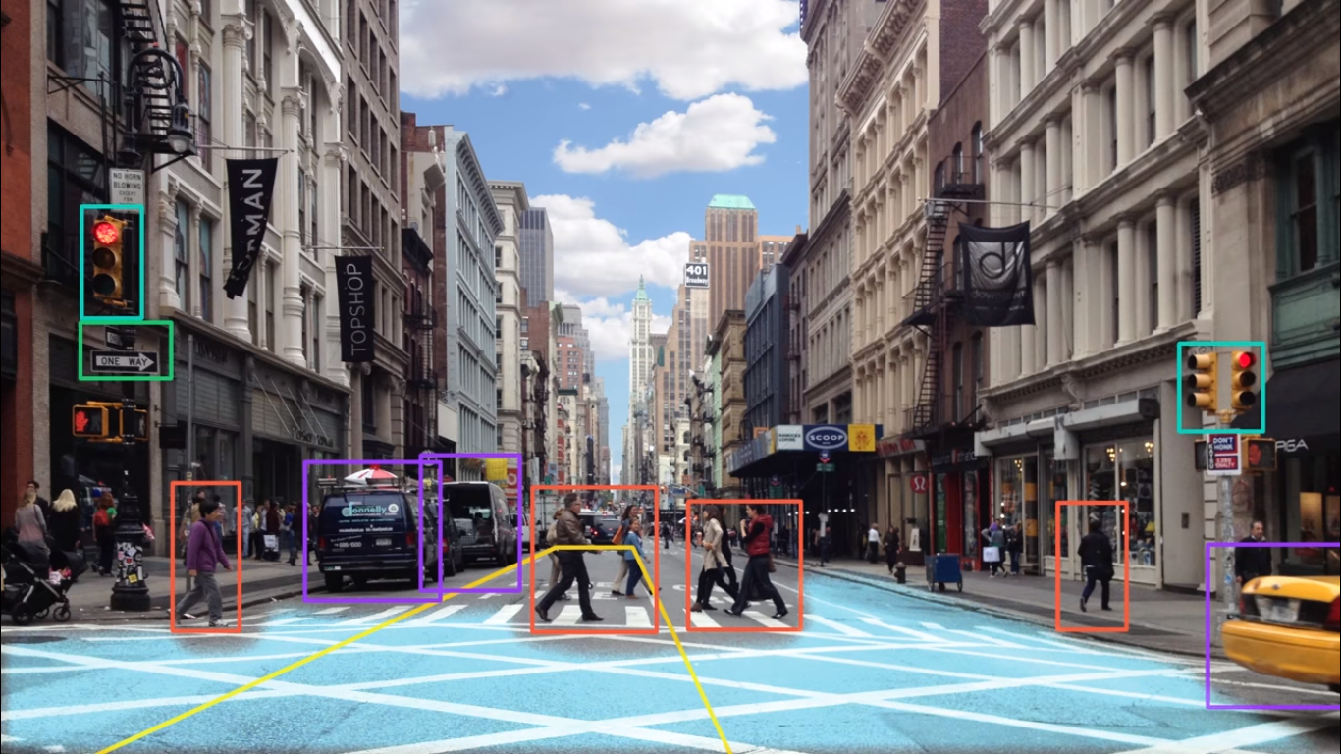
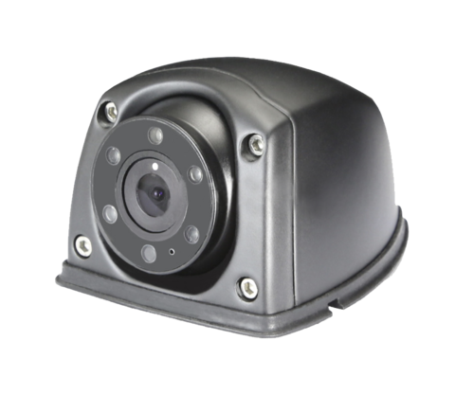
Camera

Slide 23
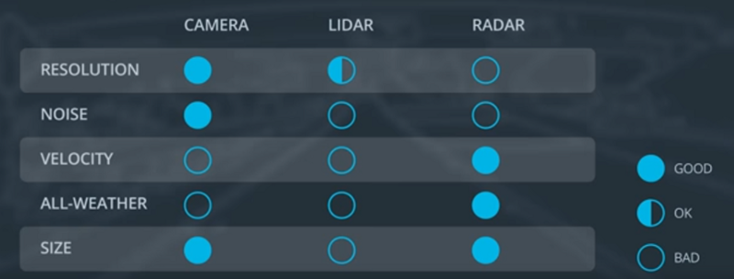
Sensor Comparison Chart

Slide 24
Autonomous Vehicle System Architecture
Sensors
Perception
Planning
Control
Camera
Radar
Lidar
GPS
Others
Detection
Route Planning
Behavior Planning
Localization
Trajectory Planning

Slide 25
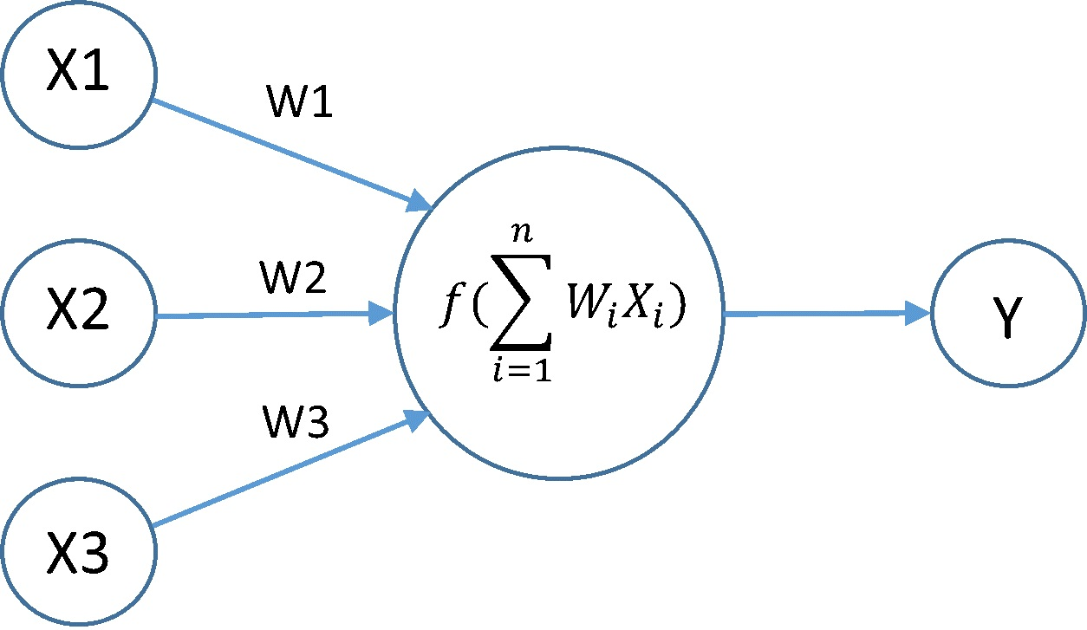
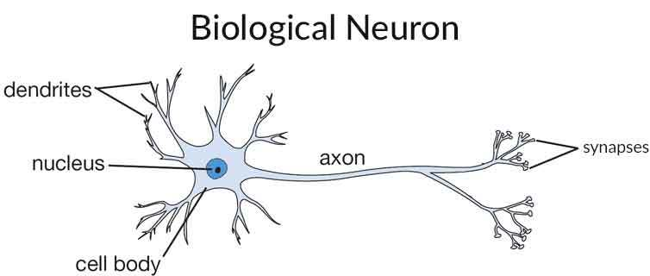
What does Artificial Intelligence (A.I.) mean ?
Artificial intelligence (AI) is an area of computer science that emphasizes the creation of intelligent machines that work and react like humans.

Slide 26
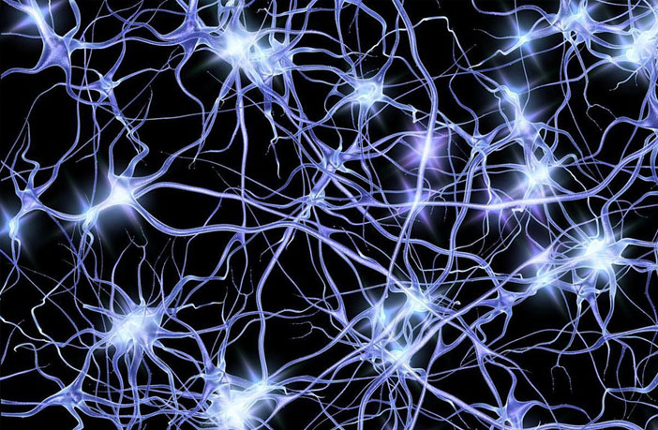
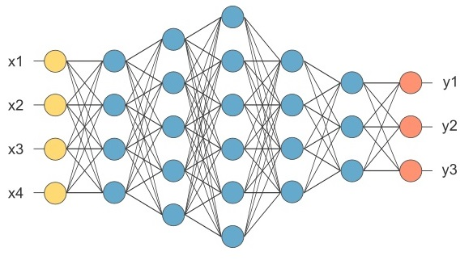
Neural Network
Neurons in Human Body
Neurons in Computer World

Slide 27
Pros and Cons
make our road safer
free up people’s time
improve mobility for everyone
expensive technology
computer malfunction could cause crashes
ethical problem

Slide 28
What Next ?

Slide 29
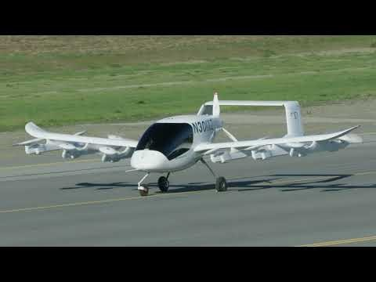

Slide 30
Any Questions ?

Slide 31
Thank-you

